Slide 1
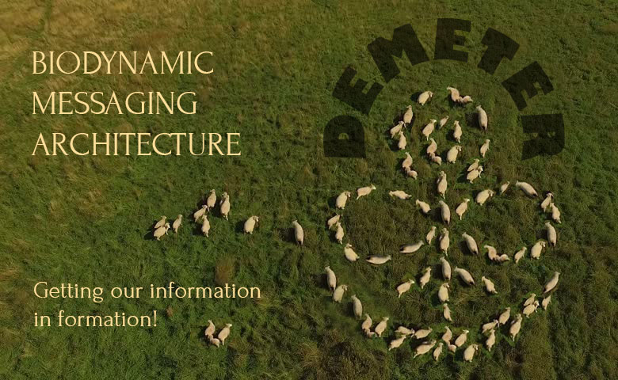


Slide 2
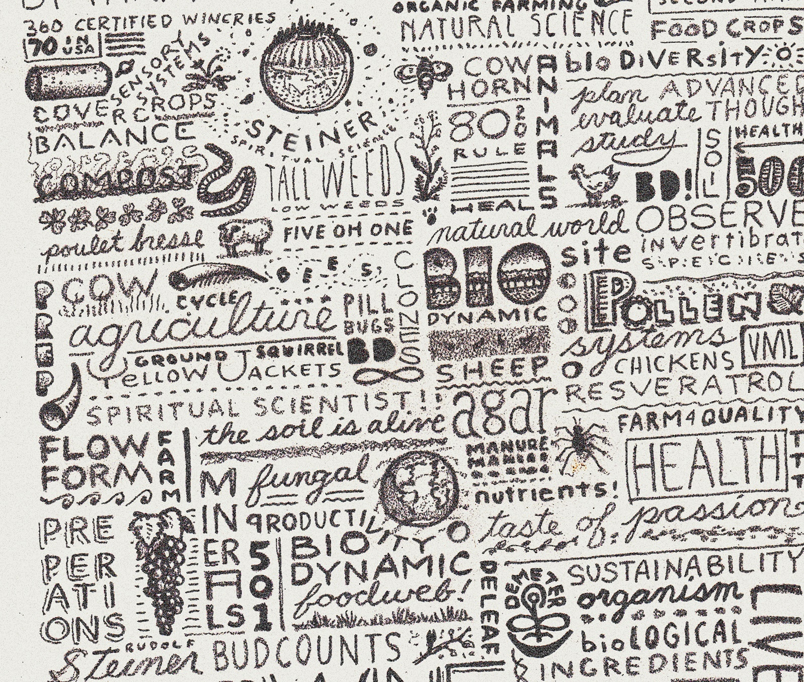
PROJECT GOAL:
Develop a strategic message architecture and key talking points to encourage consistent messaging about Biodynamic farming and food that leverages growing consumer interest and awareness.

Slide 3
CONSUMER-DRIVEN REDEFINITION OF QUALITY
IN FOOD CULTURE
Source: The Hartman Group, Organic & Natural 2018 Report
“Core consumers idealize food and agriculture that go beyond organic, and for them, organic no longer represents the highest ideal for how their food is produced. Many of the principles that Core consumers idealize are encapsulated within biodynamic farming practices and equations they make between soil health, wellness and sustainability.”

Slide 4
KEY MESSAGE PLATFORM & PILLARS
Biodynamic Farming Brings Integrity and Vitality to Farming and Food
The Wisdom of the Past and a Vision for the Future
Holistic Farming that Heals
Highest Quality Products

Slide 5
MESSAGE ARCHITECTURE
Biodynamic Farming Brings Integrity and Vitality to Farming and Food
The Wisdom of the Past and a Vision for the Future
Holistic Farming that Heals
Highest Quality Products
Original Organic
Oldest
Eco-Label
Rigorous Farm Standard
Farmer- Focused
Regenerative Ecosystems
Animal Welfare
Artisan Processing Standards
Best in Class Recognition
Healthy Soil = Healthy Food

Slide 6
The Wisdom of the Past and a Vision for the Future
Original Organic: Often referred to as the “original organic,” the Biodynamic movement began in Europe in the 1920’s as a response to the industrialization of farming.
  Instead of thinking of their farms as factories, farmers were encouraged to envision them as living organisms: self-contained, self-sustaining, following the cycles of nature.
  The term “organic” was coined years later from this original concept of the ”farm as organism”
Oldest Eco-Label: Demeter was formed by a group of farmers in 1928 to codify Biodynamic principles and practices in a Farm Standard, and to ensure its uniform adherence in the marketplace through certification.
  Named for the Greek goddess of agriculture, Demeter remains the oldest ecological certification organization in the world and operates in 50 countries around the world.
  Demeter is an independent not-for-profit certification organization, not tied to corporate or government interests.
  For a farm or product to be referenced as “Biodynamic” in the marketplace it must be Demeter certified.
Rigorous Farm Standard: Biodynamic Certification ensures that any farm bearing the Demeter seal has met the Standard’s requirements
  The farm is managed as much as possible as a closed system, so solutions for that farm’s vitality- fertility, soil health, disease and pest control- arise from the farm itself instead of being imported from the outside.
  The Demeter seal is consistently rated as the best certification program. Consumer Reports’ Greener Choices awarded the Demeter Biodynamic seal the highest rating of “Highly Meaningful” and Green America’s “Environmental Concerns Labels” awarded it 5 our of 5 stars .
  The answer to the future of farming lies in its past: Biodynamic agriculture is a solution to climate change because Biodynamic farms are carbon sequestering farms.

Slide 7
Holistic Farming that Heals
Farmer Focused: It is the intention of the farmer and their relationship to the farm that distinguishes the practice of Biodynamic from other farming methods.
  Biodynamic farmers are creative, respectful of the earth, and highly skilled. They observe, sense, and listen to their farm and work inventively with the dynamics of the land and nature to bring the vibrancy of their farm to full expression
  Biodynamic farmers create their own on-farm remedies- called Biodynamic preparations- instead of importing chemicals. The “preps” are made from materials found on the farm, and improve soil microbiology and fertility, enliven compost, and improve crop photosynthesis.
  Biodynamic farmers recognize that the health and well-being of the fields, forest, animals soil, people, and all living things above and below the ground are integral parts that make up the whole.
Regenerative Ecosystems: Biodynamic farming regenerates- it exists to leave the land better than it was found by improving soil fertility and thus, farm vitality.
  Biodynamic farms have met the requirements for organic certification, even if the farm is not organic certified.
  Keenly focused on building soil fertility, low tillage, if not no tillage, is encouraged. Integrating livestock, building compost, and utilizing cover crops generate on-farm fertility and return nitrogen to the soil. Holistically managed cattle grazing develops perennial grassland. These practices result in and depend on healthy, vibrant soil. Carbon sequestering soil.
  As the land becomes healthier, the farm becomes more resilient, building a natural resistance to disease, pests, adverse weather events and climate change.
  Within a Biodynamic farm, you won’t find a conventional parcel of land next to a Biodynamic parcel- the entire farm is 100% Biodynamic. At least 10% of the land must be dedicated to biodiversity.
Animal Welfare: Humane treatment of animals is not only encouraged, it is required.
  Animals are respected members of a Biodynamic farms. In addition to their obvious role in a farm’s fertility, they are cared for in a way that supports their inherent health and the full expression of their nature.
  Animals are given feed that is grown on the farm; calves, lambs, and kids are raised on their mother’s milk; housing must allow animals to move freely; poultry cages are prohibited and access to free range, forage, and the outdoors is required.
  Chickens keep their beaks; cows keep their horns; and piglet tail cutting is prohibited.

Slide 8
Highest Quality Products
Healthy Soil = Healthy Food: Our food is only as good as the farming that produces it.
  Deficiencies in soil and plants lead to deficiencies in the human diet. There is a direct correlation between soil fertility and human health.
  Soil-centered farming creates nutrient dense food that is delicious and nutritious.
  Biodynamic farmers farm for flavor.
Artisan Processing Standards: Featuring the most stringent food processing standards in the world, Demeter Biodynamic certification expands on the requirements set forth by USDA certified Organic.
  Instead of one processing standard for all products (as in the USDA Organic Processing Standard), there are sixteen Biodynamic processing standards for different categories of foods. For example, there are specific processing standards for fruits and vegetables, nuts and seeds, herbs and spices, meats, cosmetics and body care, milk and milk products, wine, and textiles.
  The intention of all the processing requirements is to allow the integrity of the agricultural ingredients to define the finished product. Minimal processing for maximum nutrition, flavor, and quality.
“Best in Class” Recognition: Biodynamic certified foods and wines are recognized as “best in class” in taste and overall quality
  Four Demeter certified dairies were included in the Cornucopia Institute’s Organic Dairy Scorecard top 11 “5 star/cow” rated dairies.
  A study published in the Journal of Wine Economics found that Biodynamic wines scored an average of 4.1 points higher (out of 100) than conventional wine
  Two Expo East 2018 Nexty awards awarded to White Leaf Provisions for their recently introduced Biodynamic® fruit spreads: ”Best New Organic Food” and “Best New Pantry Food.”
  (List other current awards)

Slide 9

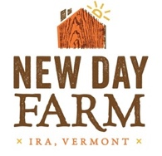


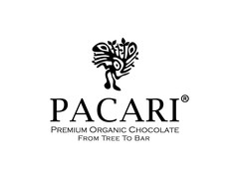

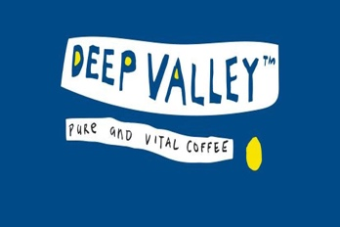
MANY THANKS TO OUR PROJECT SPONSORS
Please visit the Demeter ”For Members” section of our website for more marketing materials
www.demeter-usa.org/for-members

